Slide 1
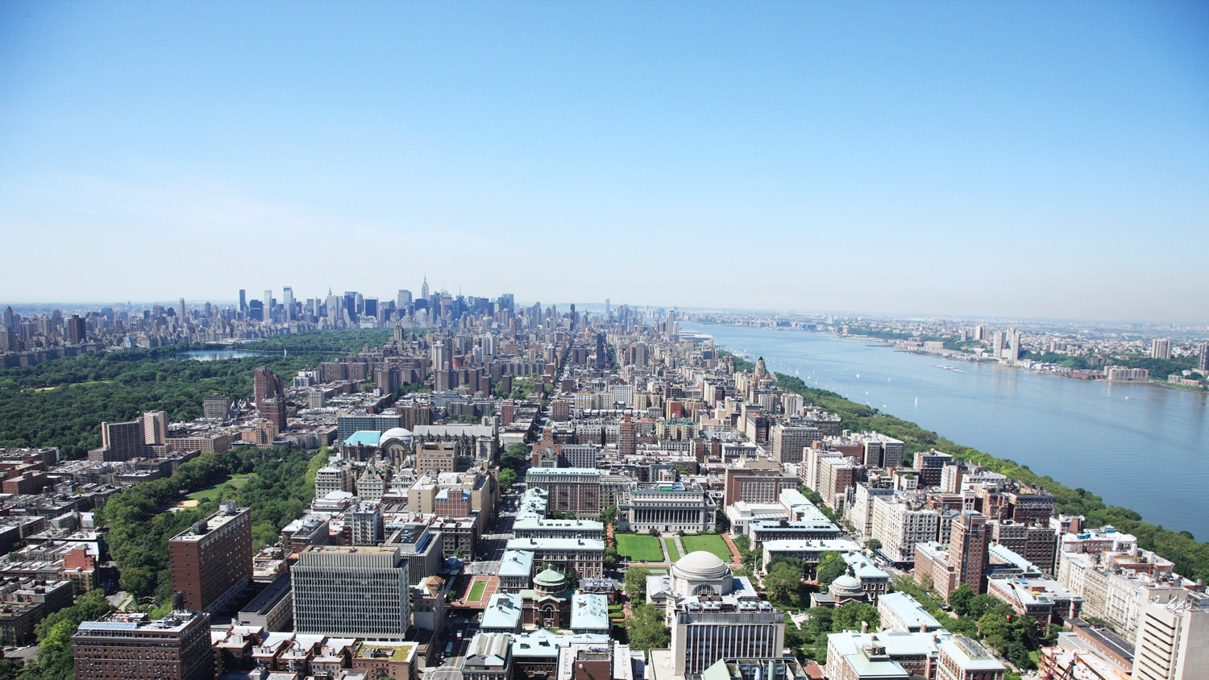


Proactive Tension Management with Product Similarity Tool
May 4th, 2023

Slide 2
Agenda
1
Project overview
2
Project roadmap
3
Solution
4
Demo
5
Results and next steps
1/9

Slide 3

Project overview
Louis Vuitton wants to develop a tool to find alternative products that allow supply chain managers to meet demand expectations when they run into tension due to production delays
LV Supply Chain team
The Supply Chain team is in charge of maintaining a steady stock availability and spends a lot of resources on optimizing stock movement. The team wants to reduce production delays resulting from external and internal factors that impact their ability to meet demand.
Mission statement
Design and implement an easy-to-use proactive tension management tool to recommend similar alternative products with strong availability for supply chain managers.
Original process
Current process uses an excel file with simple similarities decided manually by a team once a year
Our solution
Build a self-updating user-friendly tool that is backed by state-of-the-art machine learning algorithms that will automatically determine similar products with strong availability.
2/9

Slide 4




Project roadmap
Information
Gathering
Solution’s
Design
Algorithm Implementation
Testing and Deployment
Interview supply chain managers to understand current needs
Research on current machine learning methods available for similarity models
Identify most critical roadblocks to widespread usage of similarity tool
Create roadmap for solving this pain point by defining objectives and deliverables
Define other use cases for the similarity tool
Design a user-friendly interface for managers
Improve feature similarity model
Implement deep learning model for image similarity
Combine the two parallel similarity models
Create user interface for the combined machine learning model
Test and compare different alternatives for image similarity model
Test and iterate user-friendly interface to interact with the model
Deploy user interface in clients’ settings
3/9

Slide 5

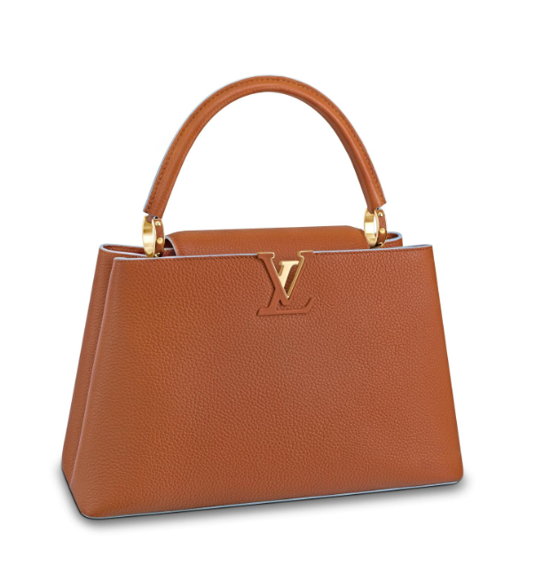
Combining different data sources, we obtain a dataset of relevant product features and a folder with all the images
Access to the URLs containing the images can only be done via LV internal network:
1
Develop a static solution using JPG files of a subsample of the data
2
Modify code to load the images from the URLs, for the deployment of the solution
…
SKUs
Price
Image
SKU
Color
Family
Gender
Price
Material
…
URL
M51777
MARRON
DAILY BAGS
WOMEN
$5750
LEATHER
https://eu.lou...
…
Full dataset
Sample of image files
4/9

Slide 6
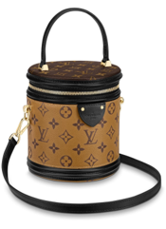
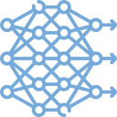
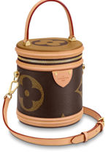
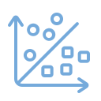
Back-end: Two Machine Learning models work in parallel to generate a similarity score for each product pair
Input
Model
Features vector
Interim scores
Combination
Output
JPG image files
Image URLs
Conv. Neural network (VGG16)
Vector obtained by removing last layer of the CNN
Cosine distance between vectors
Weighted average of intermediate scores
Similarity matrix with a similarity score for each product pair
Image similarity
0.28 | 0.01 | 0.16 | 0.04
0.21 | 0.91 | 0.97 | 0.48
0.9
x0.6
0.65 | 0.67 | 0.91 | 0.68
0.53 | 0.65 | 0.83 | 0.25
0.86
Product features (color, price, family…)
Unsupervised learning model
PCA
Numerical vector of features embedding
Cosine distance between vectors
Weighted average of intermediate scores
Feature similarity
B55042
Beige
$1550
…
0.65 | 0.67 | 0.91 | 0.68
0.53 | 0.65 | 0.83 | 0.25
0.8
x0.4
M09161
Brown
$2050
…
0.28 | 0.01 | 0.16 | 0.04
0.21 | 0.91 | 0.97 | 0.48
5/9

Slide 7

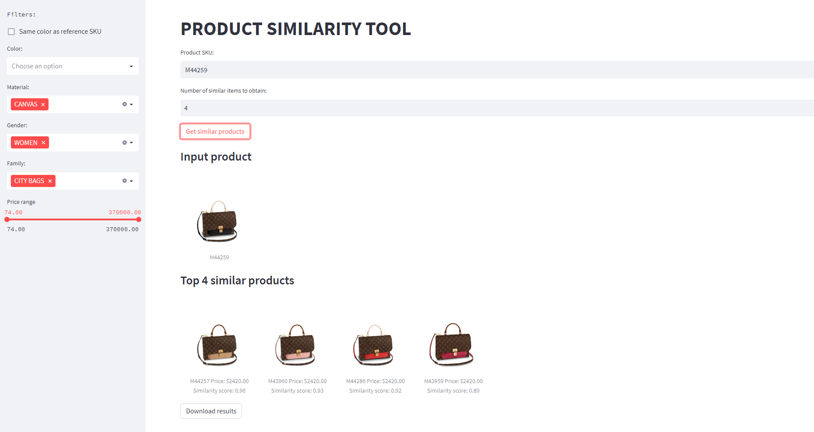


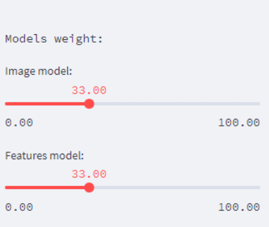
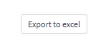
Front-end: A user-friendly interface for supply chain managers to find alternative products based on customizable filters
We interviewed with stakeholders to determine main requirements…
… And define a three-phase approach to implement the user interface
1
First MVP – non-customizable version
Used by non-technical people
Easy to manipulate
Coded using Python and Streamlit library
2
Ordering and filtering
Ease of use
3
Weights for model combination
Phase II
Phase I
Customization of model weights
Wide variety of filters
Possibility of reordering top products
User control
Top-level output
Image of the top similar products
List/link to the top 50
Excel file generation of recommendations
Phase III
6/9

Slide 8

The tool we developed is a user-friendly and flexible interface meeting all the requirements
7/9
Notes:
https://youtu.be/z16h5wQwZlE

Slide 9





The proactive tension tool improves the supply-chain team performance through the use of Machine Learning and a comprehensive UI design
From manual interaction…
… to one-click solution
Time
Days of manually assessing data, deciding on manual solutions
Instant
Analyses amount
Updated once a year
Updated automatically on demand
Analysis
depth
Limited number of filters on Excel due to manual interaction
Advanced Machine Learning models for image and feature similarity
Accuracy
No metric
Decided by human eye
State-of-the-art NN built on millions of data points
Usability
Required coding expertise to use previous tool
Whole supply-chain department can interact with the tool
8/9

Slide 10




Key learnings and next steps
Next steps for the Supply Chain Team
Conduct usability tests and user satisfaction interviews to find other UI improvements
Add Real-Time stock availability information to the recommendations
Train model on GPUs for faster run time
Evaluate other image similarity algorithms (YOLOv5, YOLOtiny…)
Expand the use of similarity tool for the LV main website for customer use
We overcame roadblocks such as accessibility to the database and blocked URLs by firewall
Tool accessible by all LV supply chain team department via Streamlit Share
Data availability is key for the smoothness of the tool functionality
9/9

Slide 11

Q & A

